Slide 1
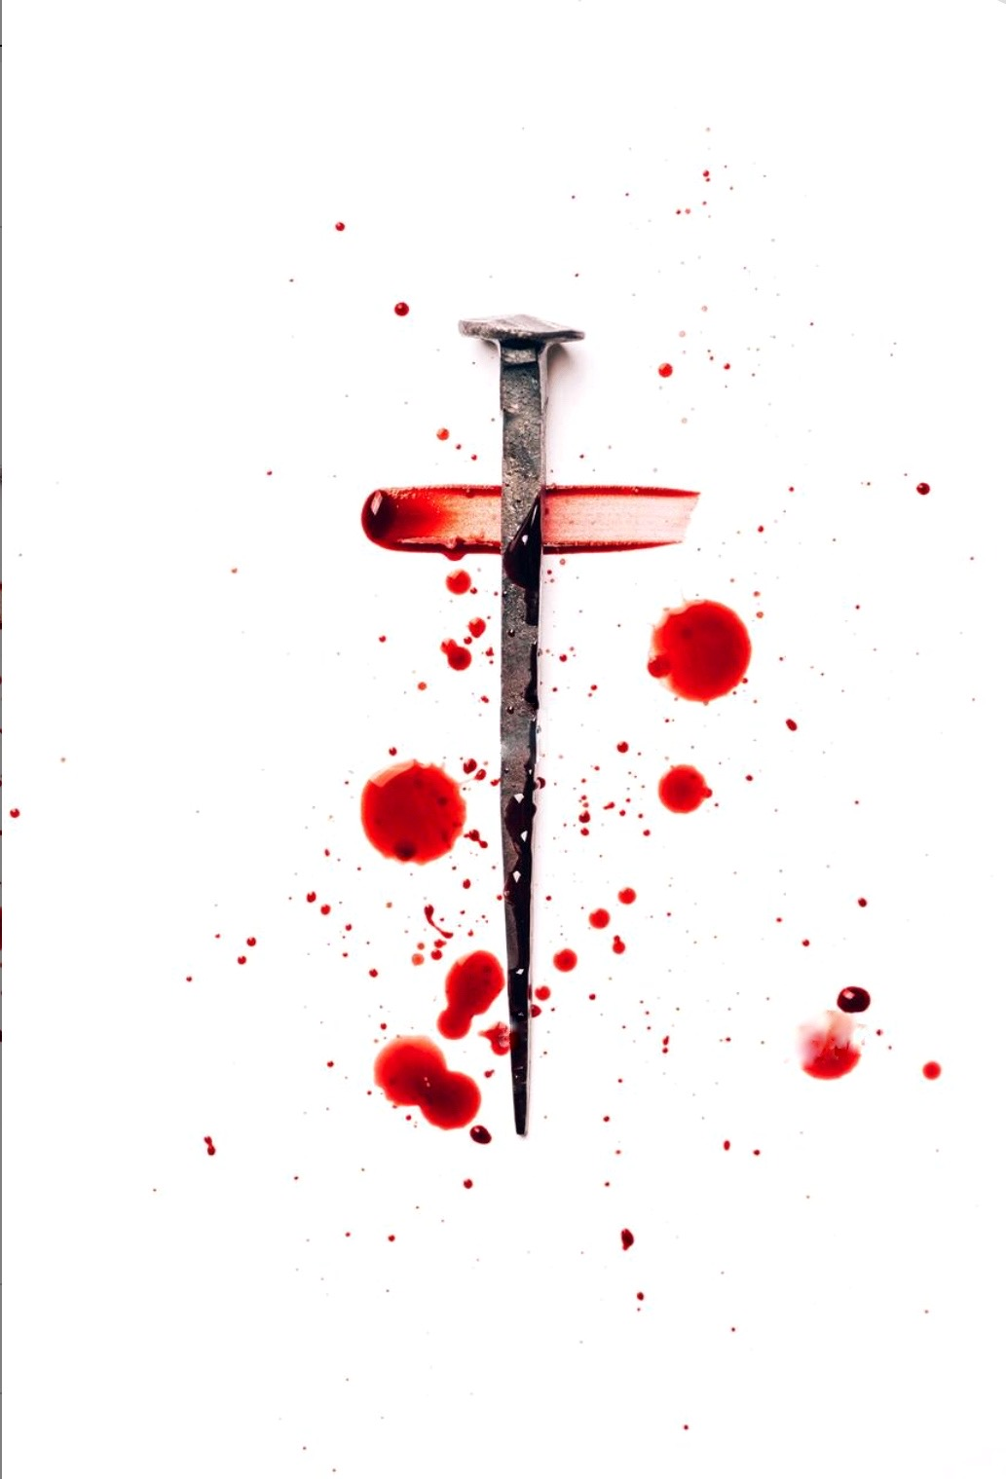
我每思念十字宝架
When I Survey the Wondrous Cross
188

Slide 2
我每思念十字宝架，
并主如何在上悬挂；
万般尊贵今看有损，
从前所夸今觉鄙下。
When I survey the wondrous cross
on which the Prince of glory died,
my richest gain I count but loss,
and pour contempt on all my pride.
我每思念十字宝架 1/4

Slide 3
我在主前一无所夸，
除了基督的十字架；
前所珍爱虚空荣华，
今为祂恩情愿丢下。
Forbid it, Lord, that I should boast
save in the death of Christ, my God!
All the vain things that charm me most,
I sacrifice them through his blood.
我每思念十字宝架 2/4

Slide 4
看从祂头祂脚祂手，
慈爱忧伤和血而流；
爱忧交织自古未有，
荆棘化作主的荣耀。
See, from his head, his hands, his feet,
sorrow and love flow mingled down.
Did e'er such love and sorrow meet,
or thorns compose so rich a crown?
我每思念十字宝架 3/4

Slide 5
假若世界都归我有，
尽献於主仍觉不够；
主爱如此奇妙深厚，
当得我心我之所有。
Were the whole realm of nature mine,
that were a present far too small.
Love so amazing, so divine,
demands my soul, my life, my all.
我每思念十字宝架 4/4

Slide 6
主爱如此奇妙深厚，
当得我心我之所有。
Love so amazing, so divine,
demands my soul, my life, my all.
我每思念十字宝架 4/4

